Slide 1

Online Gaming Company Analysis
Presented By:
G. Sai Chaitanya

Slide 2
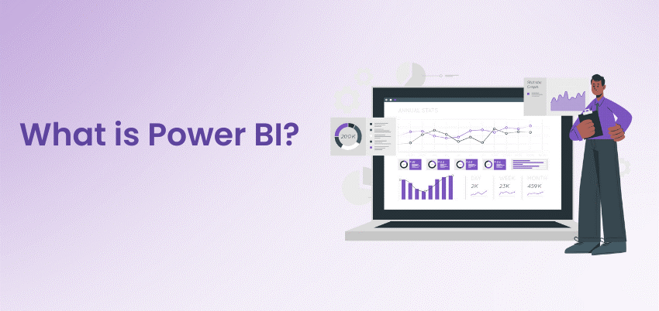

Slide 3
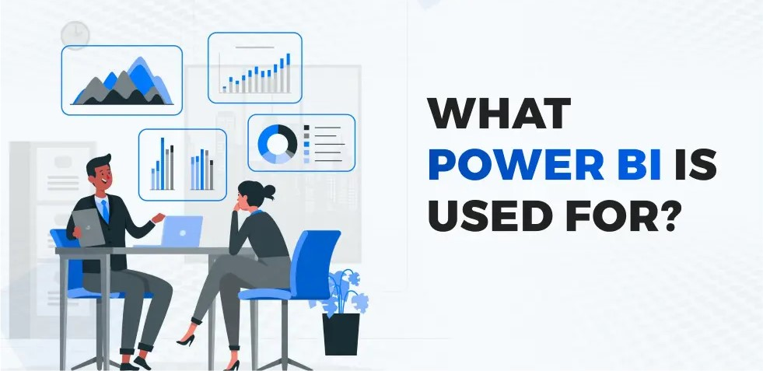

Slide 4
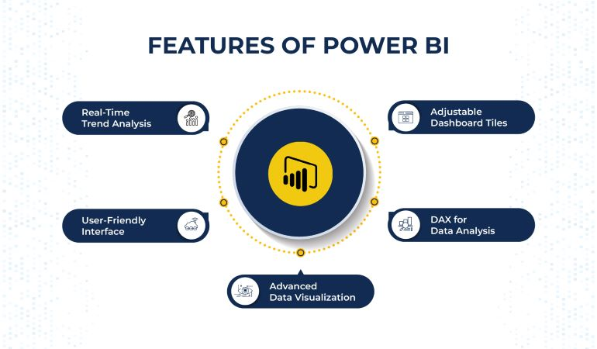

Slide 5
INTRODUCTION
This project provides an analytical overview of user behaviour, company performance, and compliance risks.
The dashboards were developed using Power BI with imported datasets, focusing on key performance metrics, user demographics, and trends in complaints and bans.

Slide 6
PROBLEM STATEMENT
With the rapid growth of online gaming platforms companies face challenges in identifying high-performing markets, addressing rising complaints, and ensuring compliance in regions with app bans. The objective of this project is to analyse user-level and company-level data to provide actionable insights for better decision-making.

Slide 7
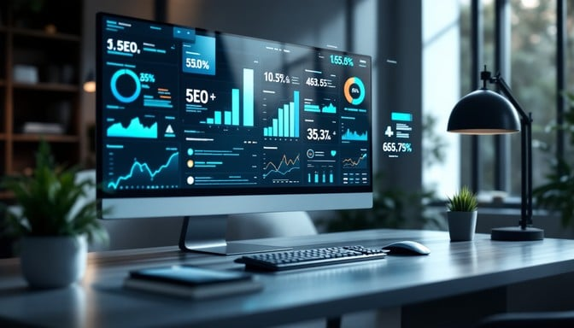
DATASETS USED
a) user_level_dataset
Key attributes include:
ActivityDate
AgeGroup
AppBanned
BanImpact
Banned_AppName
Company
DailyUsageHours
Date
MonthlySpending
RecordID
ReportFiled
State
UserID

Slide 8
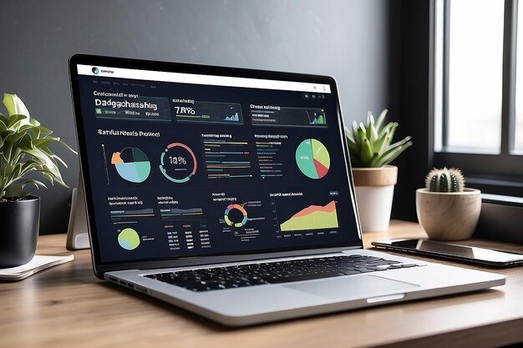
b) company_summary
Key attributes include:
CompanyID
Company
AppsBanned
AvgDailyUsage
ComplaintsFiled
DAU
MAU
TotalRevenue
TotalUsers

Slide 9
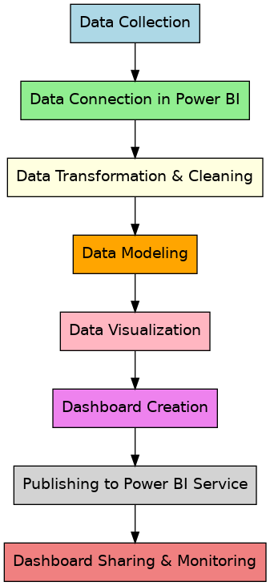
IMPLEMENTATION

Slide 10

DATA VISUALISATION
Dashboard 1 – Company Overview
Cards (Revenue, Users, DAU, MAU)
Line Chart(Revenue vs Company)
Clustered Column Chart (Impact of Revenue on MAU)
Donut Chart (Apps Banned Distribution)
Slicer(Activity Date)
Key Influencers

Slide 11

Dashboard 2 – User Insights
Cards (TotalUsers, AvgDailyUsage, DailyUsageHours)
Stacked Bar Chart(Users By State)
Pie Chart (Users vs ReportsFiled)
Table(UserCount by State)
Q&A
Line Chart(DailyUsageHours, Company)

Slide 12
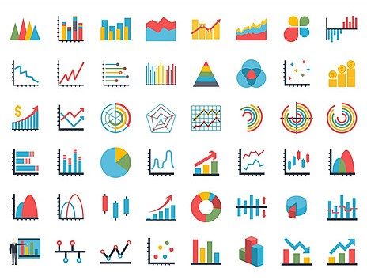
Dashboard 3 – Risk & Compliance
Cards/KPIs (Total_Complaints, Total_AppsBanned)
Stacked Column Chart(ComplaintsFiled by Company)
Stacked Bar Chart(Bans by Company)
Area Chart (Complaints vs Bans Trend)
Line Chart(AppsBanned by State)
Summary
Donut Chart(ReportsFiled vs Ban Impact)

Slide 13

CONCLUSION
This project integrates company-level and user-level data to provide a clear view of performance and risks.
By analyzing revenue, user demographics, and complaints, the dashboards allow stakeholders to make informed decisions.
This structured approach supports both strategic planning and compliance monitoring in the online gaming sector.

Slide 14

FUTURE ENHANCEMENTS
Add predictive analytics for forecasting revenue and complaints.
Integrate sentiment analysis from user feedback.
Include churn prediction to identify at-risk users.
Add real-time monitoring for compliance and bans.

Slide 15


Slide 16

ANY
QUERIES?

